Slide 1
SOFTWARE ENGINEERING
Software Architecture
Georgios Dimitrakopoulos

Slide 2
Software architecture
Software architecture is the basic framework for building a system.
Software architecture identifies the subsystems that make up a system and defines the framework for their control and communication.
Architectural design decisions include the application type, the distribution of the system, and the architectural styles to be used.

Slide 3
Architectural design
Early stage of the systems design process.
It connects the specification and design processes.
It is often carried out in parallel with other activities related to specifications.
It includes identifying the main components of the system and their communication.

Slide 4
Advantages of a well-designed architecture
Communication with stakeholders The architecture can be the focus of discussions with stakeholders about the system.
System analysis implies that it is possible to analyze whether the system will be able to satisfy its non-functional requirements.
Large-scale reuse There may be the possibility of reusing the architecture across multiple systems.

Slide 5
System architecture and features
Performance Local limitation of critical functions and minimization of communications. Use of coarse rather than detailed components.
Protection from external risks Use of multi-tiered architecture, with critical resources at the internal levels.
Security Local limitation of safety-critical features to a small number of subsystems.
Availability Inclusion of redundant components and fault tolerance mechanisms.
Maintainability Use of detailed, readily replaceable components.

Slide 6
Disadvantages - Architectural contradictions
The use of component parts improves performance, but reduces maintainability.
Introducing redundant data improves availability, but makes it difficult to protect against external risks.
Locally restricting security-related features usually involves more communication, thus reduced performance.

Slide 7
System Building
It concerns the decomposition of the system into interacting subsystems.
Architectural design is usually illustrated with a structural diagram that presents a high-level view of the structure of a system.
More specific models are also distributed that show how subsystems use data together, while interfaces between them can also be developed.

Slide 8
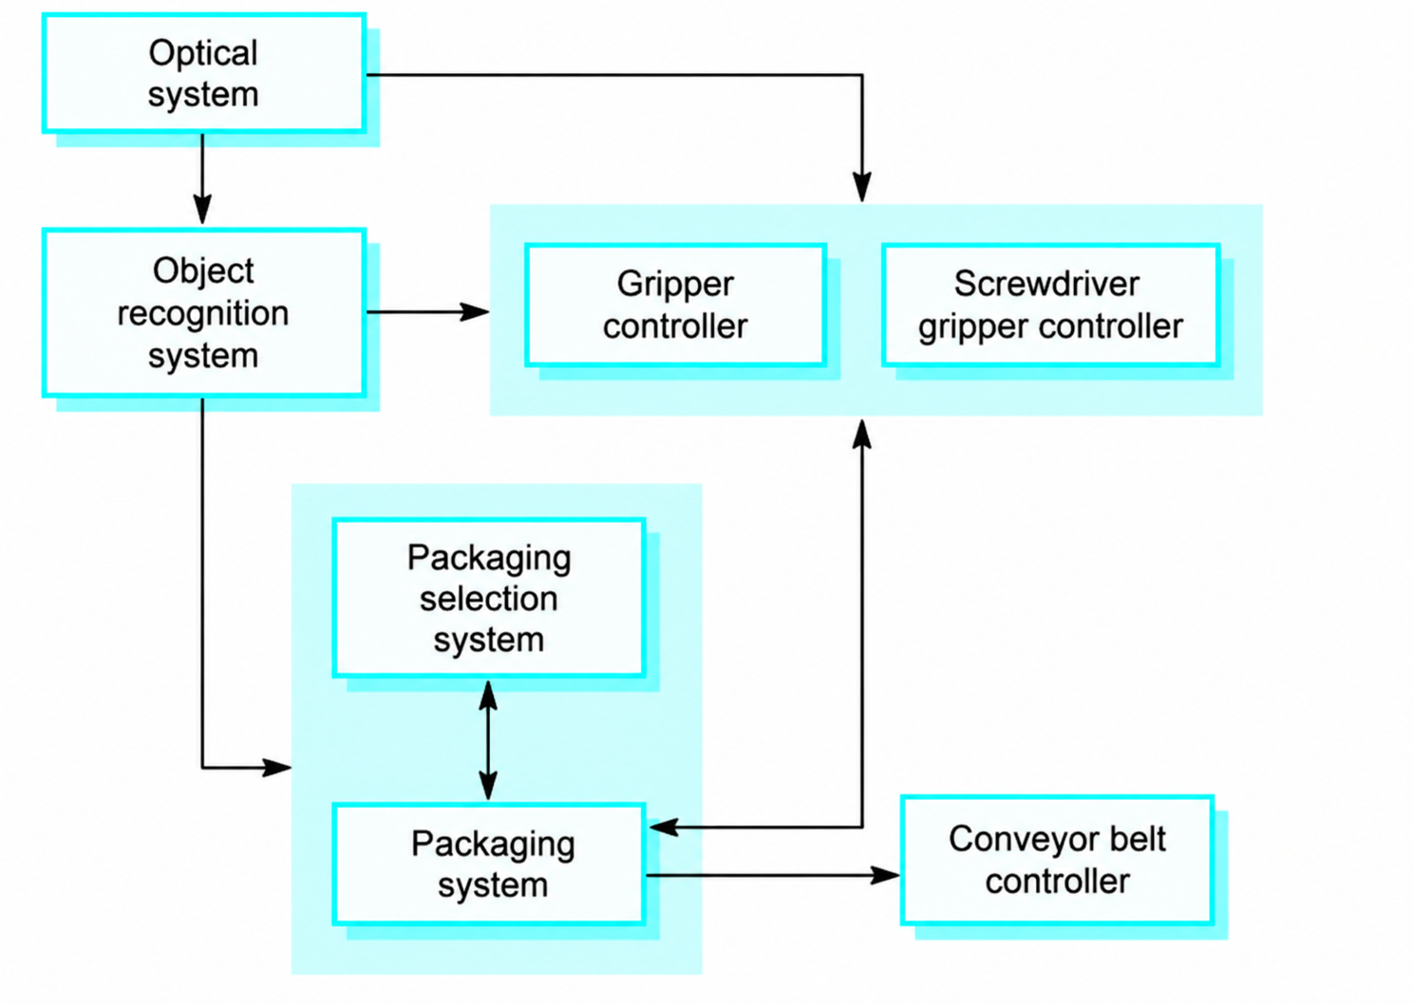
Example: robotic packaging control

Slide 9
Architectural Design Decisions
Architectural design is a creative process, which differs depending on the type of system being developed.
However, all design processes are influenced by a series of fundamental decisions.

Slide 10
Architectural Design Decisions
These decisions include:
Is there a general application architecture that can be used?
How will the system be distributed across multiple processors?
What architectural styles are suitable?
What approach will be used to build the system?
How will the system be decomposed into subunits?
Which control strategy should be used?
How will the architectural design be evaluated?
How should the system architecture be documented?

Slide 11
Architectural Reuse
Systems that belong to the same application domain often have similar architectures that reflect the fundamental concepts of the domain.
Application product lines are structured around a central architecture, with variants that meet specific customer requirements.

Slide 12
Architectural styles
The architectural model of a system may follow a general architectural model or style.
Awareness of these styles can simplify the problem of defining the system architecture.
However, most large systems are heterogeneous and do not follow a single style.

Slide 13
Architectural Models
They are used to document architectural design.
Static structural models: present the main components of the system.
Dynamic process models: show the process structure of the system.
Interconnection models: define the interconnections of subsystems.
Relationship models: show the relationships between subsystems, for example data flow models.
Distribution models: show how subsystems can be distributed across multiple computers.

Slide 14
System Organization
It reflects the basic strategy for building a system.
Three organizational styles are widely used:
The shared data repository.
Shared services and servers.
The abstract machine style (or multi-layered style).

Slide 15
Repository Model
Subsystems need to exchange data. This can be done in two basic ways:
  Shared data is stored in a central database or repository and can be accessed by all subsystems.
  Each subsystem maintains its own database and shares data explicitly with the other subsystems.
When large volumes of data are to be shared, the repository model is most often used.

Slide 16
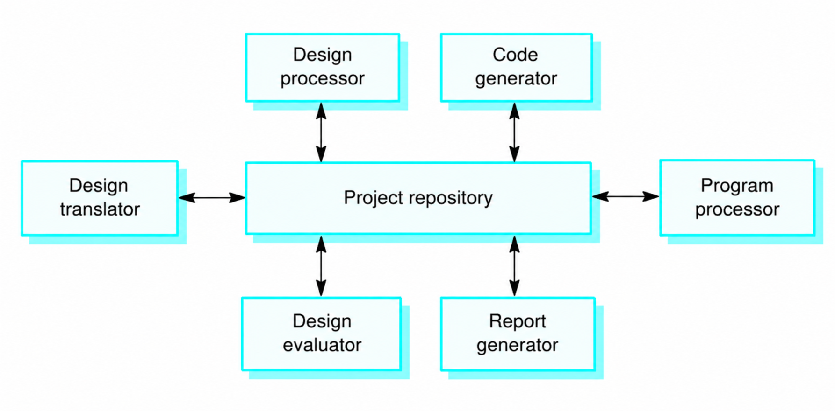
Example: The architecture of a complete CASE toolkit

Slide 17
Features of the Repository Model
Advantages
Efficient way to share large amounts of data.
The way data is produced does not concern the subsystems.
Centralized management (e.g. backups, protection from external risks, etc.).
The model for sharing is visible through the repository schema.
Disadvantages
The subsystems must agree on the repository data model. This is a compromise.
Data evolution is difficult and costly.
There is no provision for specialized management policies.
Efficiently distributing the repository across multiple machines can be difficult.

Slide 18
Client-Server Model
It is a distributed system model that shows how data and its processing are distributed across a multitude of component elements.
Includes:
A set of standalone servers that provide specific services (such as printing services, data management services, etc.).
A set of customers who use these services.
A network that allows clients to access servers.

Slide 19
Example: library of old movies and photos
Library client
Catalogue server
Network
Web client
Media server

Slide 20
Characteristics of the Client-Server Model
Advantages
Easy data sharing.
Efficient utilization of networked systems. Cheaper hardware is required.
Easily add new servers or upgrade existing ones.
Disadvantages
There is no common data model, so subsystems organize their data in different ways.
Data exchange may not be efficient.
Redundant management functions on each server.
There is no central name and service registry - it may be difficult to find available servers and services.

Slide 21
Abstract Machine Model
Also known as layered architecture.
It organizes the system into layers, where each layer provides a set of services to the immediately higher layer.
It supports incremental system development. As a layer is added, it builds on the services of the layer immediately below.
During development, it is possible to replace a layer with a different and more efficient implementation.

Slide 22
Example: code version control system
User interface
Object management
Version management
Storage management
Repository

Slide 23
Characteristics of the Abstract Machine Model
Advantages
Allows layer replacement.
Isolation of layers. Changing one layer affects only the immediately adjacent layers.
Disadvantages
The practical grouping of functions into levels is often difficult.
System operation may be inefficient due to multiple communication interfaces.

Slide 24
Modular Building Models
Structural models show how the system is structured for development.
These models consist of subunits which are:
  Development components
  Recognizable
  Autonomous (can be implemented independently)
Two styles are widely used:
Object model.
Pipeline model (or filter model).

Slide 25
Object Model
The system is decomposed into discrete objects that interact with each other.
Each object is a self-contained component with:
  Its own database and functions
  No direct access to the data and functions of other objects
Objects have hidden information and define a public interface that allows other objects to access them.

Slide 26
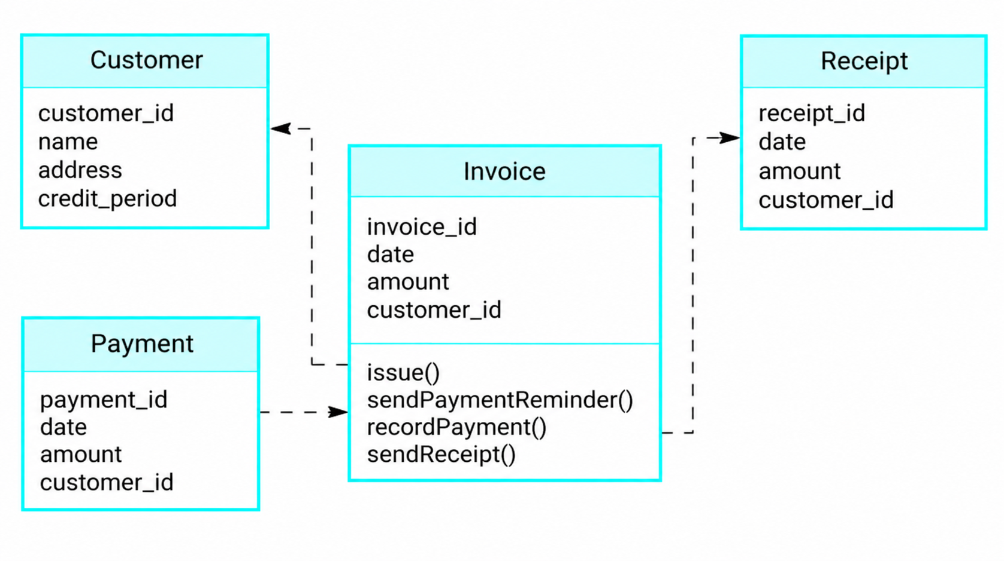
Example: Invoice system

Slide 27
Characteristics of the Object-Oriented Model
Advantages
Objects are loosely coupled, so their implementation can be modified without affecting other objects.
Objects can be representations of real-world entities.
There is widespread use of object-oriented programming languages.
Disadvantages
However, possible modifications to the object interface can cause problems, while it can still be difficult to represent complex entities as objects.

Slide 28
Pipeline and Filter Model
Alternative name: Functionally Oriented Pipeline Model
Functional transformations process input data and produce output data.
The system is organized as a series of processing elements (known as filters).
Data flows through these components (known as pipelines).
Data flows in one direction only.
It is usually used in data processing systems.

Slide 29
Pipeline and Filter Model
It is called the pipe and filter model, from the terminology used in UNIX.
Variants of this approach are commonplace. When the transformations are serial, then the architectural model is a serial batch processing model, which is used extensively in data processing systems.
Not recommended for interactive systems.

Slide 30
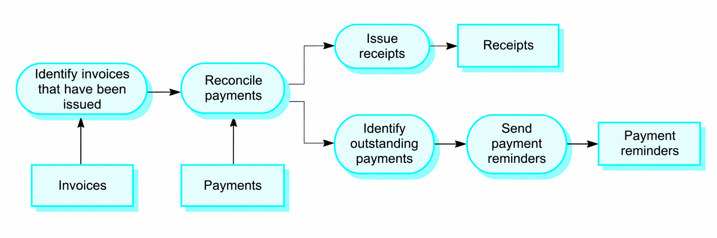
Example: Invoice management system

Slide 31
Funnel model features
Advantages
Supports the reuse of transformations.
Intuitively understandable organization that facilitates communication with stakeholders.
Easy to add new transformations.
Relatively simple implementation of the system, either as serial or as simultaneous.
Disadvantages
It requires a common format for transferring data along the pipeline, while at the same time it is difficult to support event-based interaction.

Slide 32
Control style
It concerns the flow of control between subsystems. It is separate from the system decomposition model.
Centralized control:
  One subsystem has overall responsibility for controlling, starting and stopping the other subsystems.
Event-based control
  Each subsystem can respond to externally generated events from other subsystems or from the system environment.

Slide 33
Centralized Control Model
A subsystem is the central controller and is responsible for managing the execution of other subsystems.
There are two main forms of this model:
  Call–Return Model.
  Manager Model.

Slide 34
Call-Return Model
It is used in centralized systems.
Control starts at the top of the hierarchy and is performed by a main program.
The system's functions are included in its subroutines or procedures.
Control starts at the top of the tree and moves down to the lower levels.
It is applicable only to serial systems.

Slide 35
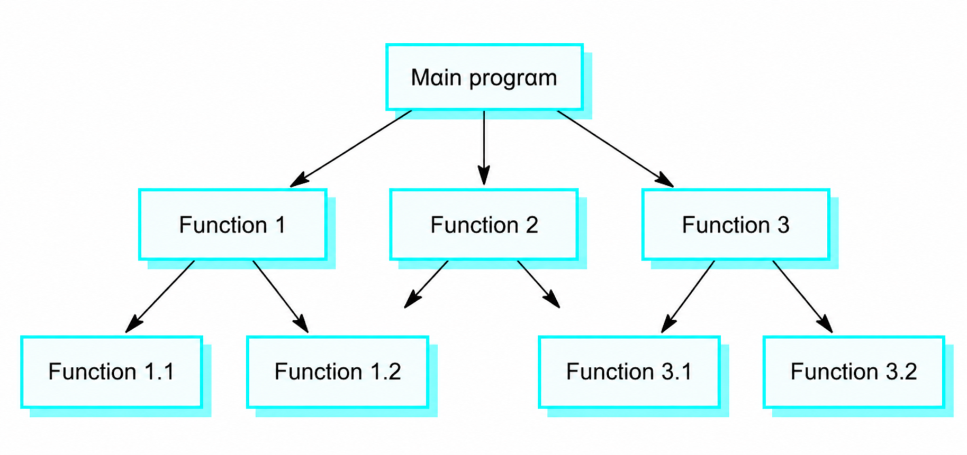
Example: Call-Return Model

Slide 36
Administrator Model
It is applied to concurrent systems.
The administrator is responsible for:
  The beginning
  The interruption
  Coordination of the remaining subsystems.
This model is often implemented together with the object model.
It only applies to concurrent systems.

Slide 37
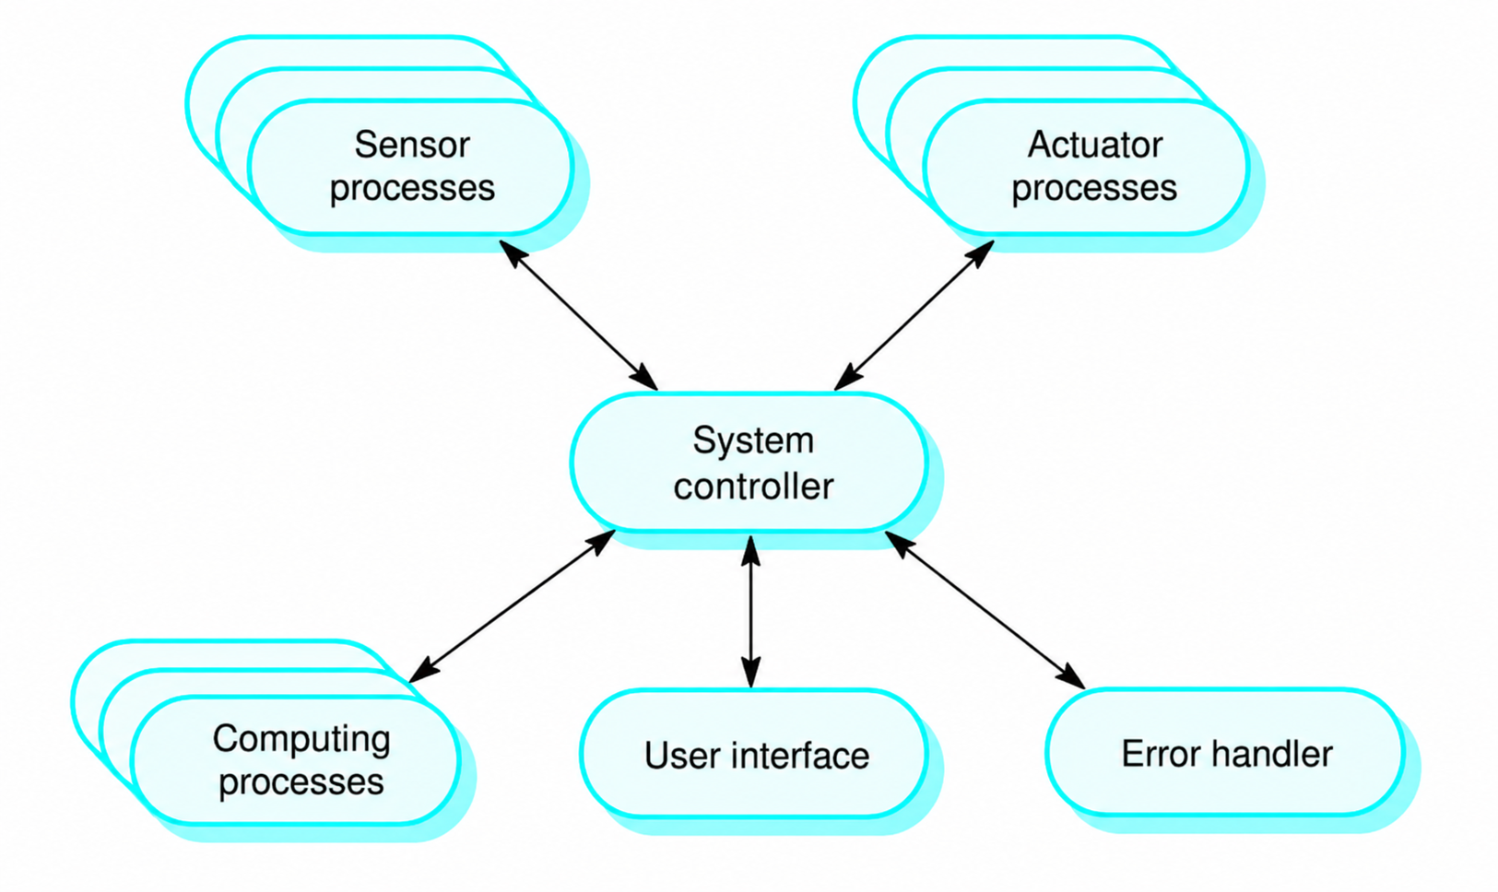
Example: Administrator Model

Slide 38
Event-driven Model
The subsystems of the system operate in parallel and compete for control.
The control is decided by an external event that occurs, which triggers its processing by one of the subsystems.
This model is often applied to real-time and interactive systems.
Types:
  Emission Model
  Holiday Model

Slide 39
Broadcast Model
It is effective in integrating subsystems that are distributed across various computers on a network.
Subsystems declare interest in some specific events.
When one of these events occurs, control is transferred to the subsystem that can handle that specific event.
The control policy is not built into the event and message handler. Subsystems decide which events concern them.
However, they do not know if and when an incident will be handled.

Slide 40
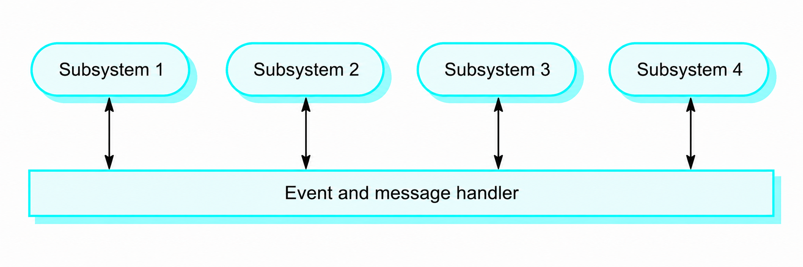
Example of a broadcast model

Slide 41
Interrupt-driven Systems
They are used in real-time systems, where a quick response to an event is essential.
There are a known number of types of interrupts, each of which has a handler defined.
Each interrupt type corresponds to a memory location and a hardware switch causes control to be transferred directly to its handler.
They allow for quick response, but their programming is complex and their validation is difficult.

Slide 42
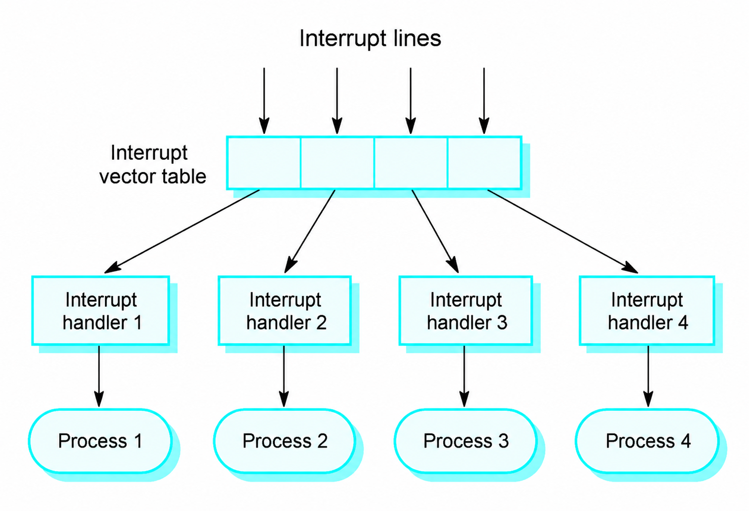
Example: Interruption-driven control model

Slide 43
Reference Architectures
Architectural models may only be suitable for specific application fields.
There are two types of domain architecture models:
  General models: Abstractions that represent a set of real systems and encapsulate the main characteristics of these systems.
  Reference models: More abstract, idealized models. They are a way of providing information about a specific class of systems and a way of comparing architectures.
Typically, general models are synthetic in their approach, while reference models are analytical.

Slide 44
Reference Architectures
Reference models usually result from a study of the scope of application and not a study of existing systems.
They can form the basis for implementing a system or for comparing different systems.
They constitute standards against which systems can be evaluated.
The OSI model is a multi-layered model of communication systems.

Slide 45
OSI Reference Model
7 Application
6 Presentation
5 Session
4 Transport
3 Network
2 Data Link
1 Physical

Slide 46
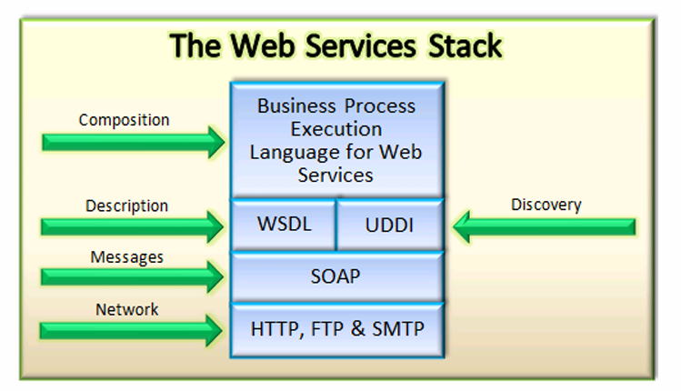
Web services stack

Slide 47
Modern architectural choices
Classic styles remain useful; today they are combined with new forms of organization and development.

Slide 48
From a Monolith to a Distributed System
Monolithic application
A development unit
Simple operation and testing
Strong coupling when growing up
Modular monolith
Clear internal boundaries
One development, independent modules
A good starting point for development
Microservices
Autonomous services
Independent scaling/development
Greater functional complexity

Slide 49
Microservices: When Do They Make Sense?
A suitable choice when…
There are clear operational boundaries
Teams need autonomy
Scaling varies by service
There is a mature DevOps infrastructure
Warning signs
Small group or simple product
Unclear boundaries and common ground everywhere
Absence of monitoring and automation
Networks are treated as reliable

Slide 50
Hexagonal / Ports & Adapters
Core
Business rules
Doesn't know UI, base or framework
Easy clean tests
Ports
Entry and exit contracts
They define what the kernel needs
Inversion of dependencies
Adapters
Web API, database, queues, CLI
They translate technological details
They are replaced at low cost

Slide 51
Evaluating an Architecture
1. Scenarios
E.g. 10× load
2. Criteria
latency, cost
3. Options
style & tactics
4. Trade-offs
profits / risks
5. Decision
Document the decision and measure the results
The “best” architecture does not exist out of context: it is evaluated against specific quality scenarios.

Slide 52
MVC (Model-View-Controller)
It separates presentation and interaction from system data.
The system is structured in three logical components that interact with each other.
  Model: manages the system data and the operations related to it.
  View: defines and manages how data is presented to the user.
  Controller: manages user interaction (e.g. keystrokes, mouse clicks, etc.) and passes these interactions to the View and Model.

Slide 53
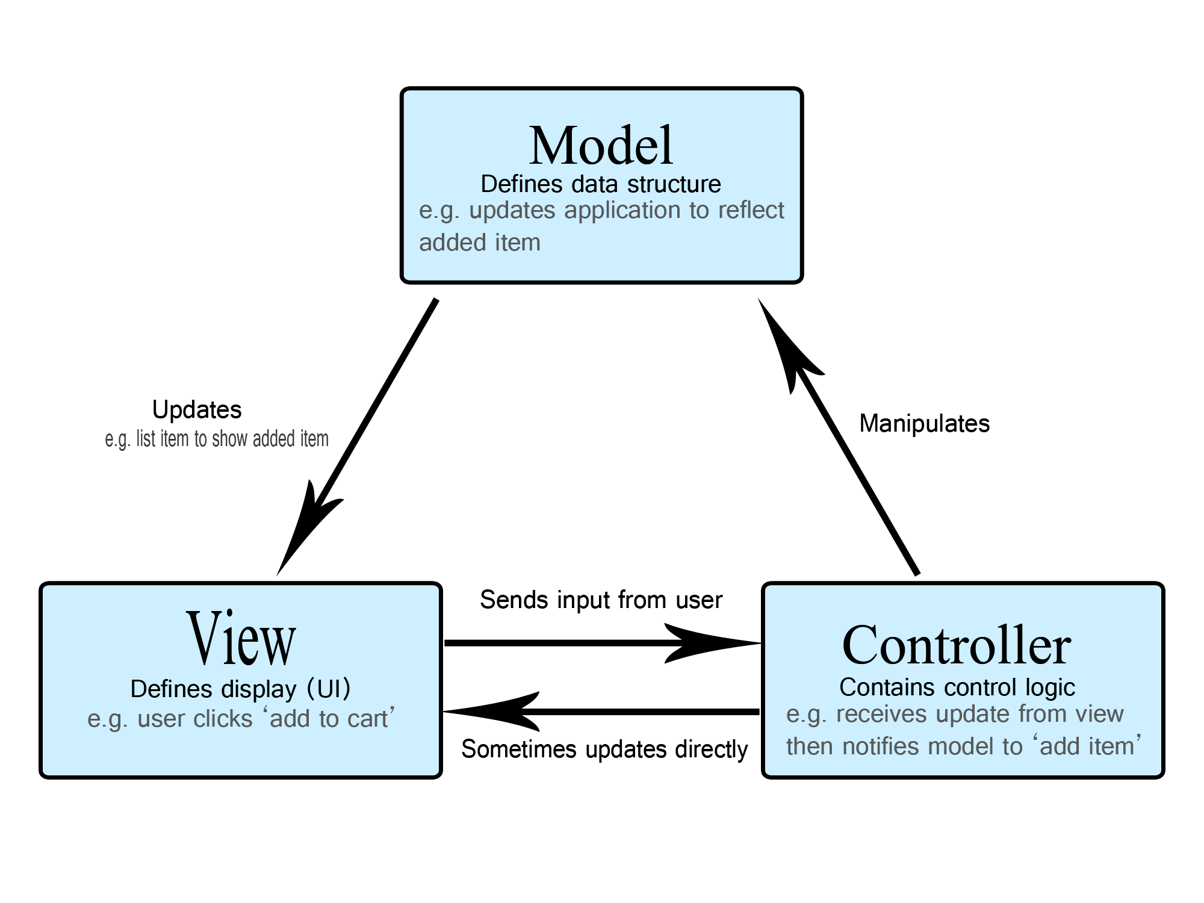
MVC

Slide 54
MVC — When to use it
It is used when there are many ways to present and interact with the data.
It is also used when future requirements for data interaction and presentation are unknown.

Slide 55
MVC in Depth
From definition to request flow, to variations and practical design decisions.

Slide 56
Responsibilities of the Three Components
Model
Status and business rules
Validation of immutable rules
Access to services/data
View
View Model visualization
Formatting and accessibility
No operational decision
Controller
Receives input/request
Coordinates use case and Model
Selects View or response

Slide 57
Flow of a Web Request in MVC
User
GET /products
Router
action selection
Controller
calls use case
Model
rules + data
View
HTML / JSON
The Controller coordinates; it should not become a repository for all business logic.

Slide 58
Example: Adding a Product to the Cart
1. Event
“Add”
2. Controller
addToCart(id)
3. Model
stock control
4. Model
cart update
5. View
new set
Availability failure → the Model returns a clear result; the Controller selects an appropriate message and status.

Slide 59
MVC and Layered Architecture
MVC
It mainly organizes the presentation level
Separates input, status, and output
Describes the interaction flow
Layers
They organize the entire system
Presentation → Application → Domain → Infrastructure
They define allowable dependencies

Slide 60
Variants and Related Patterns
Passive Model
The Controller updates the Model
View is refreshed on command
Simple and predictable flow
Active Model
The Model notifies of changes
Multiple Views are synchronized
Often with Observer/events
MVP / MVVM
Presenter or ViewModel mediates
Strong binding in MVVM
Common in rich UI

Slide 61
Benefits and Costs of MVC
Benefits
Parallel work of UI and logic
Multiple views of the same Model
Better testability
Easier interface development
Costs / risks
More files and contracts
Complexity in small applications
Fat Controllers or Anemic Model
Strong coupling with framework

Slide 62
Common Anti-Patterns
Fat Controller
Contains SQL and rules
Difficult tests
Solution: application services
Smart View
Calculates prices and policies
Doubling logic
Solution: View Models
God Model
One object does everything
High coupling
Solution: small coherent concepts

Slide 63
MVC Testing Strategy
Model tests
Clear business rules
Fast unit tests
Many borderline cases
Controller tests
Routing and status check
Mock at the outer limits
No repeat domain tests
End-to-end
Critical user paths
Actual completion
Few, consistent tests

Slide 64
Security and Performance in MVC
Safety
Identity verification before action
Authorization per use case
Input validation and output encoding
CSRF protection and secure cookies
Performance
Pagination instead of full loading
Caching with explicit invalidation
Avoiding N+1 queries
Async I/O where there is a wait

Slide 65
MVC: A Short Case Study
Use case: checkout
CheckoutController: receives command
OrderService: orchestrates the transaction
Order/Cart: enforce rules
Repository/Payment: infrastructure adapters
Result
OrderViewModel: view data only
View: summary or error page
No SQL or pricing in View
No HTML inside the Model

Slide 66
Design Exercise
Scenario
Room reservation application
The user chooses a time and room
Overlapping reservations are prohibited.
The administrator approves special requests
10 minute deliverable
Define Model, Views and Controllers
Design the “new booking” flow
Place the overlay rule
Suggest 3 automated tests

Slide 67
MVC Selection Checklist
Choose MVC when…
There is rich interaction
Many aspects are expected
Need to separate groups
Be careful…
Clear liability limits
Small and thin controllers
The Domain is independent of UI
Count…
Time to change a function
Coverage of critical rules
Coupling and response time

